Slide 1
Azure Functions – how to write serverless code
Anton Boyko
Microsoft Azure MVP
boyko.ant@live.com

Slide 2
Developer maturity level
Junior
How can I do it?
Middle
How can I do it more elegantly?
Senior
How can I NOT do it?

Slide 3
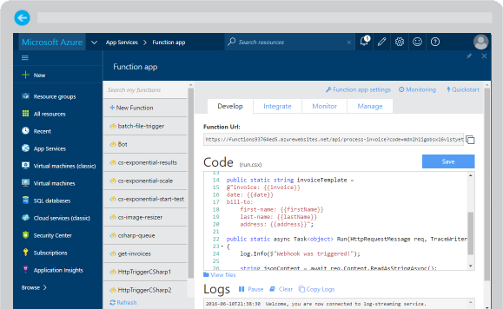
Azure Functions
Create a “serverless” event-driven experience that extends the existing Azure App Service platform by building “nanoservices” that can scale based on demand
Notes:
Azure Functions are part of the Azure Web + Mobile suite of App Services and are designed to enable the creation of small pieces of meaningful, reusable methods, easily shared across services. These serverless, event-driven methods are often referred to as “nanoservices” due to their small size. Although an Azure Function can contain quite a bit of code, they are typically designed to serve a single purpose, and respond to events in connected services.

Slide 4
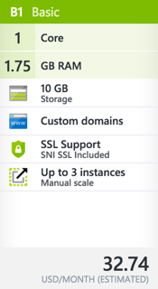
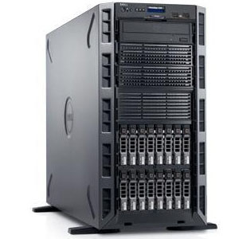
Traditional server
Fixed reserved CPU
Fixed reserved RAM
Pay for reserved resourced

Slide 5

Serverless
On-demand CPU
On-demand RAM
Pay for number of executions and on-demand resources consumed

Slide 6
Pricing model (consumption plan)
Meter | Free | Standard
Execution time | 400,000 GB-s | $0.000016 per Gb-s
Total executions | 1 Million Executions | $0.20 per Million Executions
Resource consumption is calculated by multiplying average memory size in Gigabytes by the time in seconds it takes to execute the function.
Memory used by a function is measured to the nearest 128MB up to the maximum memory size of 1,536MB.

Slide 7
Supported languages and tools
A lot of languages
.NETs
Node.JS
Not only for developers
Bash
Local emulator & CLI
Currently only for Windows
PHP
Java
Python
PowerShell
Event-based
Azure Services
Webhooks
…
Timer

Slide 8

Common scenarios
Timer-based processing
Azure service event processing
SaaS event processing
Serverless web application architectures
Serverless mobile backends
Real-time stream processing
Real-time bot messaging
Your App or Service
Office 365
Office Graph
Azure Storage
Legacy Systems
Web Services
Other Functions
Notes:
Azure Functions are “event-driven” meaning they run based on associated and configure events, or “triggers”. For example an Azure Function could be triggered by a simple timer, such as running a process once every 24-hours, or triggered by an event in a document management system, such as when a new document is uploaded to a SharePoint library. Azure Functions can also respond to Azure-specific events, such as an image added to a Storage Blob or a notification arriving in a Message Queue.

Slide 9
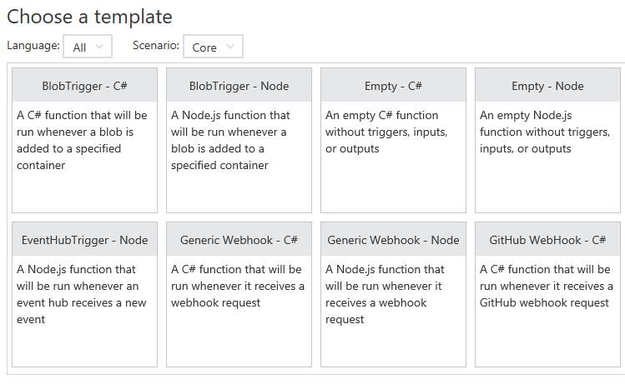
Function App templates
Function App templates are categorized into general areas of Timer, Data Processing, and Webhook & API
BlobTrigger
EventHubTrigger
Generic webhook
GitHub webhook
HTTPTrigger
QueueTrigger
ServiceBusQueueTrigger
ServiceBusTopicTrigger
TimerTrigger
Blank & Experimental
Notes:
Although Azure Functions can be created from scratch”, the Azure Portal exposes a large number of ever-growing templates to help get developers started. These templates are typically designed with specific triggers in mind, such as a Blob Storage event, or a GitHub webhook event. Templates can easily form the basis for robust function creation, and are really designed just to get a developer started.

Slide 10
Anatomy of a Function
A “Run” file that containing the function code
A “Function” file containing all service and trigger bindings and parameters
A “Project” file containing project assembly and NuGet package references
App Service settings, such as connection strings and API keys
code
Executable code
Function configuration
.NET Core and Project references
Notes:
An Azure Function is really a group of a few files that work in harmony. All actual function logic resides in a “Run” file written in a language of choice. A “Project” file is similar to a project file in other technologies such as .NET Core or Universal Windows Platform and contains “secondary” assembly references such as NuGet packages. Finally a “Function” file contains information about triggers and parameters, such as locations of Storage Queue connection strings and whether the parameter is design as an “in”, “out” or “bi-directional”. Optionally, additional configuration is also found in the Function App Settings such as an API Key or database connection string.

Slide 11
Function bindings
HTTP/webhook
Timer
Mobile Apps
Service Bus
DocumentDB
Storage Blob
Storage Queue
Storage Table
Event Hubs
Notification Hubs
Twilio

Slide 12
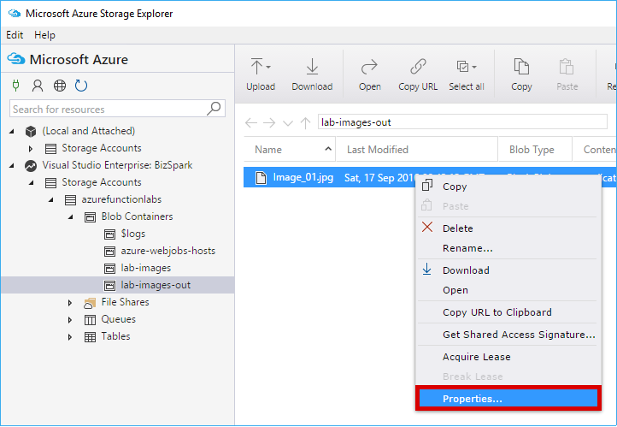
Testing Functions
Command-line tools
3rd party products such as Postman and Swagger
Direct web calls via cURL
Nested functions
Microsoft Azure Storage Explorer
Visual Studio Cloud Explorer
Notes:
Many Azure Functions are exposed via an actual URL that can be called directly from a web client or browser. When an Azure Function is not exposed via a URL its common practice to call the function from another dunction, such as a Timer-based Function for testing purposes only. Since Azure Functions can be nested, testing scenarios can be quite varied. For managing and testing Azure Functions that integrate with Storage Containers, Microsoft provides the Microsoft Azure Storage Explorer, as well as the Visual Studio Cloud Explorer. The Logs console in the Azure Function Designer is also a great way to view and trace function processing.

Slide 13
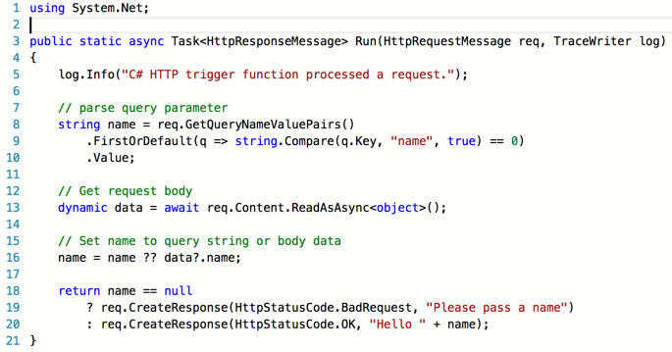

Slide 14

Questions?
Anton Boyko
Microsoft Azure MVP
boyko.ant@live.com

Slide 15


